Slide 1
CHRIST’S VICTORY OVER DEATH
Lesson 7 for November 12, 2022

Slide 2
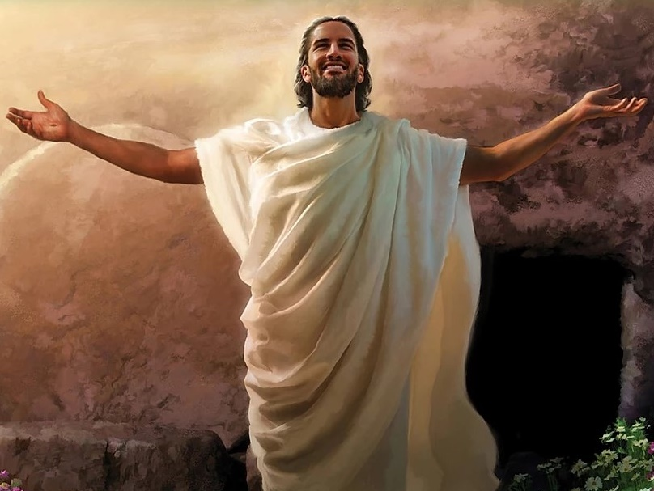
“When I saw him, I fell down at his feet like a dead man. He put his right hand on me and said, ‘Do not be afraid. I am the First and the Last. I am the One who lives; I was dead, but look, I am alive forever and ever! And I hold the keys to death and to the place of the dead.’”
Revelation 1:17, 18, NCV

Slide 3
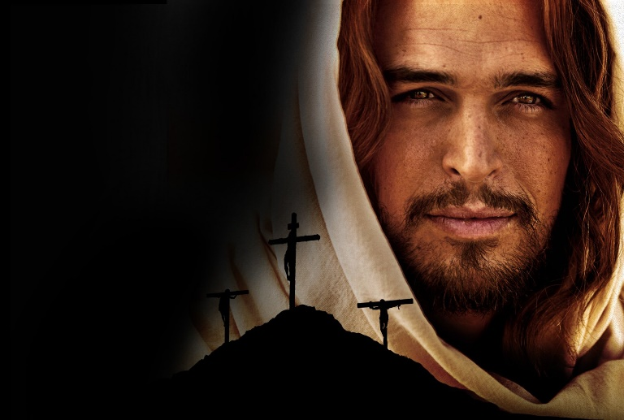
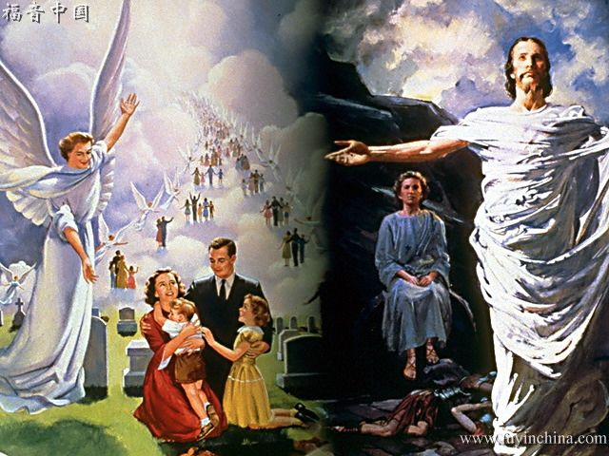
The death of Jesus at the cross is the basis of our redemption (Col. 1:14). However, a dead Savior cannot save anyone, Christ is risen!
The resurrection of Jesus marks the final victory over sin and death. It also guarantees our own resurrection.
The resurrection of Jesus:
The hindrances
The victory
The witnesses:
Those who were resurrected with Him
Those who saw Him
The importance of the resurrection:
“If Christ is not risen…”

Slide 4
THE RESURRECTION OF JESUS

Slide 5
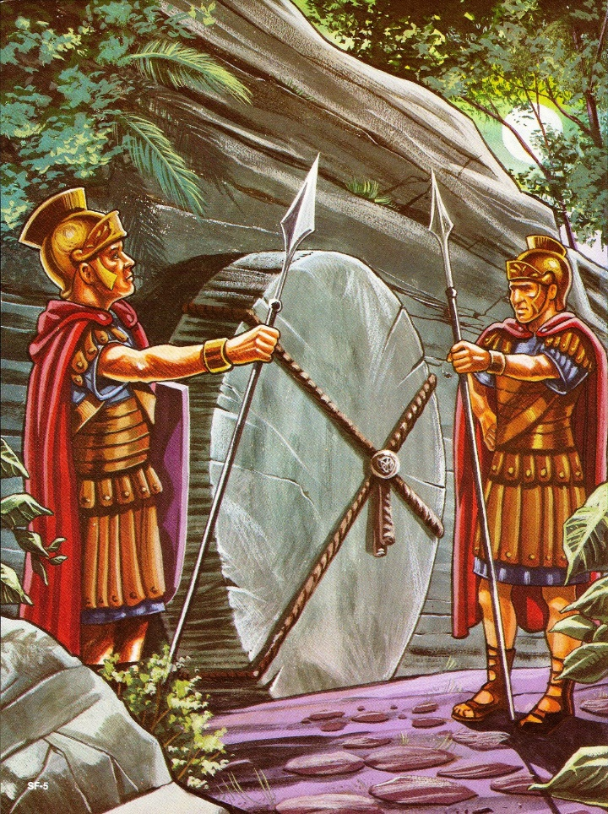
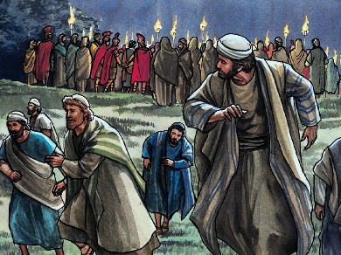
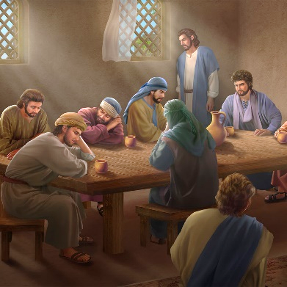
THE HINDRANCES
“So they went and made the tomb secure, sealing the stone and setting the guard.” (Matthew 27:66)
A stone, a seal, and some roman soldiers were put in place to prevent Jesus’ disciples from stealing His body (Mt. 27:62-66).
However, Jesus’ disciples were just some coward Galileans. They ran away when Jesus was arrested, and they were hiding somewhere in Jerusalem “for fear of the Jews” (Jn. 20:19).
The priests and the pharisees were not afraid of the disciples. They were afraid of Jesus. Satan encouraged them to prevent Jesus from getting out of the tomb Himself.

Slide 6
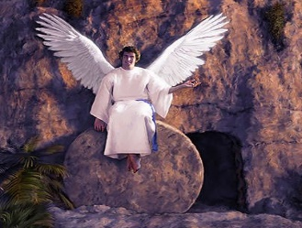
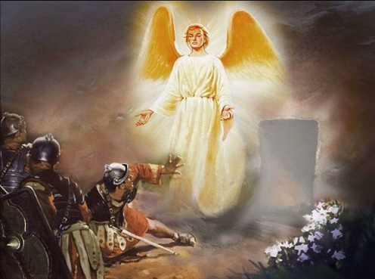
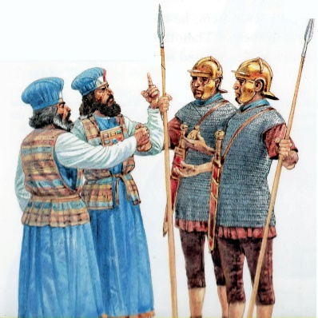
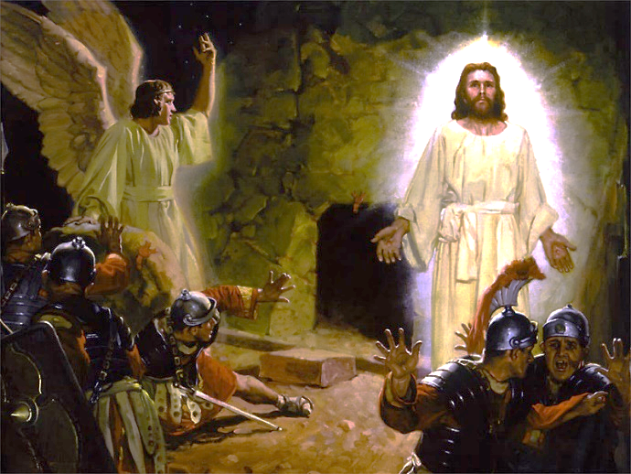
THE VICTORY
“And behold, there was a great earthquake; for an angel of the Lord descended from heaven, and came and rolled back the stone from the door, and sat on it.” (Matthew 28:2)
The stone, the seal, and the guards trembled before the presence of one angel of God. When the Father called Him, the Son took the life He had surrendered back (Acts 2:24; Jn. 10:17-18).
The elders bribed the guards to make the people believe the impossible: That the soldiers had fallen asleep, and that the disciples had removed the strong and noisy stone, taking the body of Jesus with them (Mt. 28:11-15).
The failed attempts to prevent Jesus’ victory only managed to make some scared soldiers proclaim that Jesus had been resurrected. “Christ came forth from the tomb glorified, and the Roman guard beheld Him.” (EGW, DA 780)

Slide 7
THE WITNESSES

Slide 8
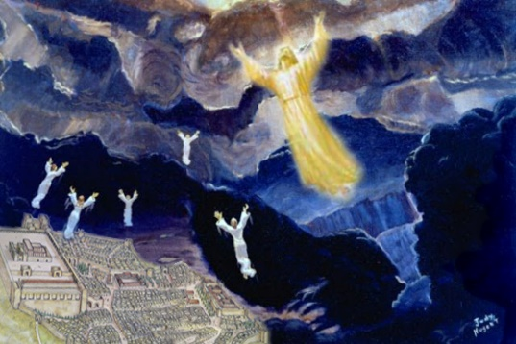
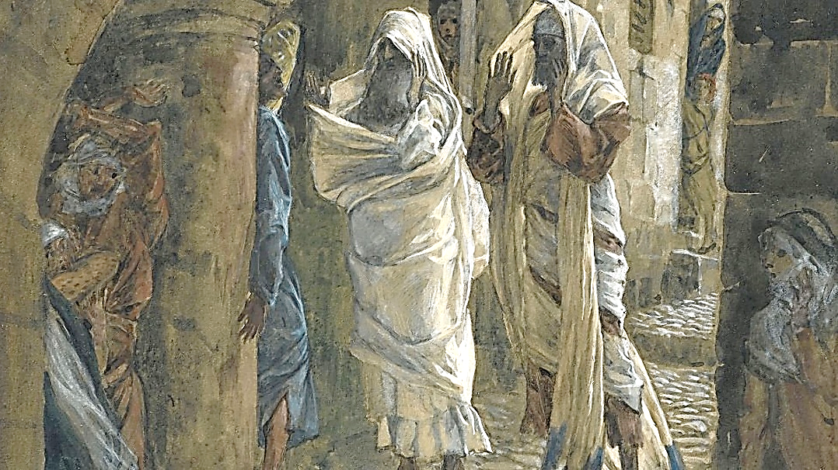
THOSE WHO WERE RESURRECTED WITH HIM
“and the graves were opened; and many bodies of the saints who had fallen asleep were raised; and coming out of the graves after His resurrection, they went into the holy city and appeared to many.” (Matthew 27:52-53)
The stones that covered the tombs of some saints were removed by an earthquake. They remained in their tombs until a second earthquake marked the resurrection of Jesus and theirs.
These people were resurrected incorruptible and ascended to Heaven with Jesus (Eph. 4:8 NIV), unlike other people who were resurrected to die again (like Lazarus or the daughter of Jairus).
Before ascending, they appeared to many in Jerusalem and testified of the resurrection of Jesus.

Slide 9
THOSE WHO SAW HIM
“The Lord is risen indeed, and has appeared to Simon!” (Luke 24:34)
As written in the New Testament, many people saw Jesus resurrected and became witnesses of His resurrection (Acts 2:32).
A group of women (Mt. 28:8-10)
The roman guards (Mt. 28:11)
Mary Magdalene (Mr. 16:9; Jn. 20:16-18)
The Emmaus disciples (Lk. 24:13-15; Mr. 16:12)
Peter (Lk. 24:34; 1Co. 15:5)
Those gathered in the upper room (Mr. 16:14; Jn. 20:19)
Thomas (Jn. 20:24-26)
More than 500 people (1Co. 15:6; Mt. 28:16-17)
James, the brother of Jesus (1Co. 15:7)
Paul (1Co. 15:8)
We’re also witnesses of His resurrection by faith (Jn. 20:29).

Slide 10
THE IMPORTANCE OF THE RESURRECTION

Slide 11
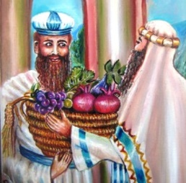
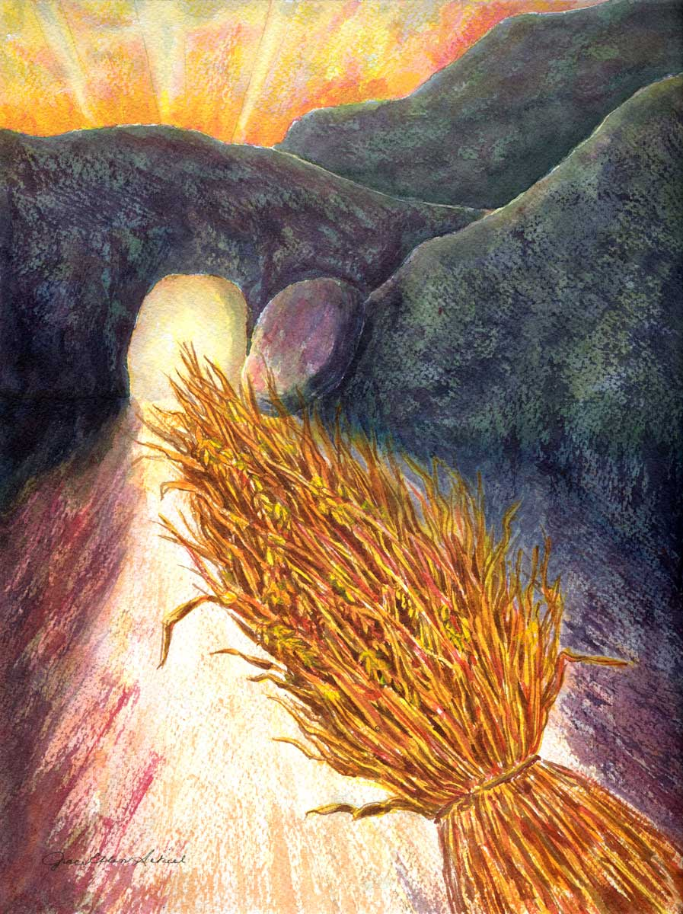
“IF CHRIST IS NOT RISEN…”
“But now Christ is risen from the dead, and has become the firstfruits of those who have fallen asleep.” (1 Corinthians 15:20)
The firstfruits were an offering to God. The first and best fruit from a field was offered (Dt. 26:1-11). It represented the whole harvest.
According to 1 Corinthians 15, if Jesus is not risen, our faith is futile. Since Jesus is risen:
v. 14
v. 15
v. 16
v. 17
v. 19
Our preaching makes sense
We testify that God is truthful
We believe that we will also be resurrected
v. 18
We have faith that our sins are forgiven
We’ll see those who have died again
We have hope in a better life
Finally, the resurrection of Jesus guarantees that the last enemy (death) will be defeated (1Co. 15:26, 54-55)

Slide 12
E. G. W. (The Desire of Ages, cp. 81, p. 785)
“Christ arose from the dead as the first fruits of those that slept. He was the antitype of the wave sheaf, and His resurrection took place on the very day when the wave sheaf was to be presented before the Lord. For more than a thousand years this symbolic ceremony had been performed […] The sheaf dedicated to God represented the harvest. So Christ the first fruits represented the great spiritual harvest to be gathered for the kingdom of God. His resurrection is the type and pledge of the resurrection of all the righteous dead. ‘For if we believe that Jesus died and rose again, even so them also which sleep in Jesus will God bring with Him.’ 1 Thessalonians 4:14”

